Slide 1
Core Java

Slide 2
What is Java?
Java is a general-purpose, class-based, object-oriented programming language designed for having lesser implementation dependencies. n Microsystems in 1995.

Slide 3
Used for?
Android Apps
Enterprise Software
Mobile java Applications
Scientific Computing Applications
Big Data Analytics
Hardware devices
Server-Side Technologies like Apache, JBoss, GlassFish, etc.

Slide 4
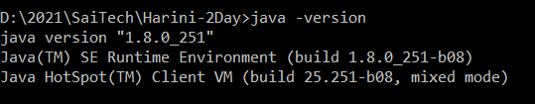
How to install Java?
https://docs.oracle.com/cd/E19182-01/820-7851/inst_cli_jdk_javahome_t/
https://www.youtube.com/watch?v=IJ-PJbvJBGs
Set Path for Java_home/jdk/bin
https://www.javatpoint.com/how-to-set-path-in-java
D:\2021\SaiTech\Harini-2Day>echo %JAVA_HOME%

Slide 5
What is JDK?
JDK contains tools required to write Java programs and JRE to execute them.
It includes a compiler, Java application launcher, Appletviewer, etc.
Compiler converts code written in Java into byte code.
Java application launcher opens a JRE, loads the necessary class, and executes its main method.

Slide 6
JVM
It provides a runtime environment in which Java bytecode can be executed.
It can also run those programs which are written in other languages and compiled to Java bytecode.
Task:
Loads code
Verifies code
Executes code
Provides runtime environment

Slide 7
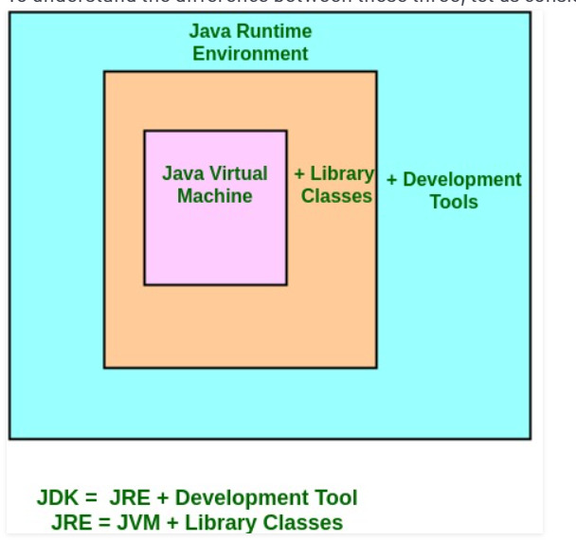
JRE
The Java Runtime Environment is a set of software tools which are used for developing Java applications.
Provide the runtime environment.
Implementation of JVM.
It physically exists.
It contains a set of libraries + other files that JVM uses at runtime

Slide 8
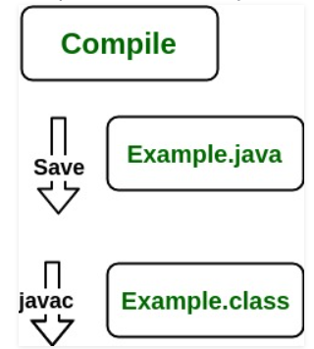
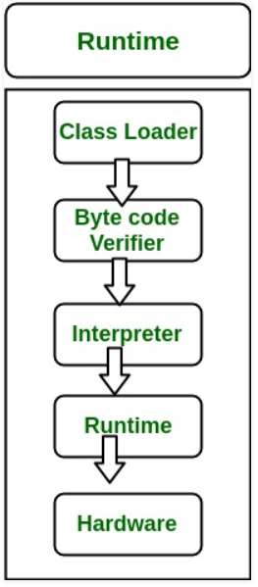
JRE Functionatlity

Slide 9
Install Eclipse
https://www.eclipse.org/downloads/packages/release/oxygen
https://www.edureka.co/blog/setup-eclipse-ide/
Editors, Views, and Perspectives

Slide 10
Setting up a Project
Creating a Hello Java Application
Demonstrate the Debug application
Set breakpoint
Click on debug icon
Press F8

Slide 11
How to import existing Project in Eclipse
File-> New-> JavProject-> Name the project
Rc project-> import -> FileSystem-> Select Path (D:\2021\SaiTech\Harini-2Day\SampleData) -> Run the code
https://www.youtube.com/watch?v=REViWzhUfag

Slide 12
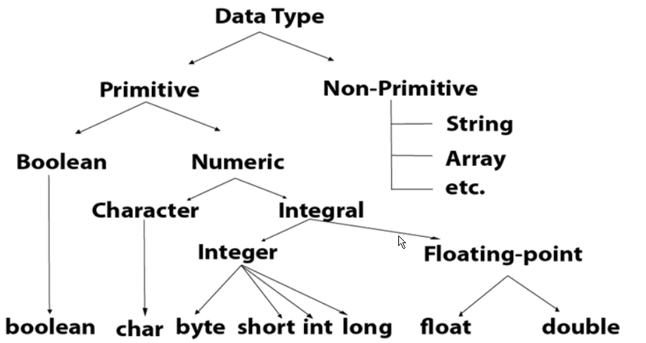
Data Types

Slide 13
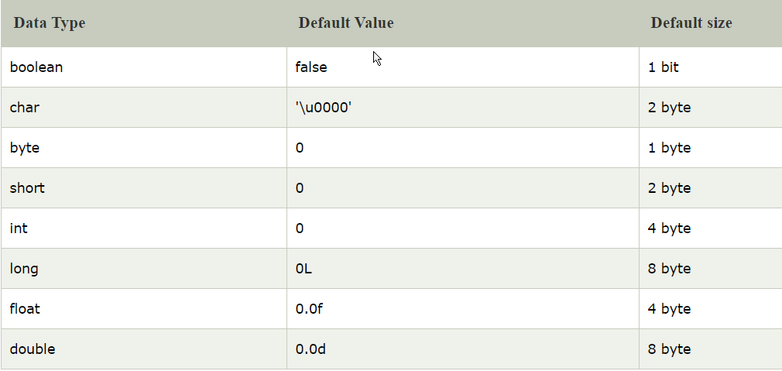
Data Type

Slide 14
Lab:
com.datatype
com.condition
Assignment
Check the pass or fail.
Check vowel or consonent

Slide 15
Loop
For
Do while
While
Assignment – Print triangle of numbers

Slide 16
String
Concat
Equals
toLowerCase
substring
indexOf
charAt
Assignement
Check string palindrome
Reverse the string

Slide 17
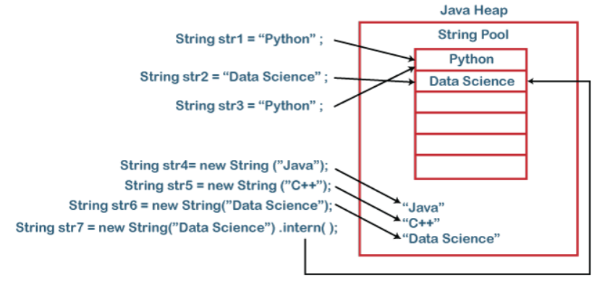
String Pool
String pool is nothing but a storage area in Java heap where string literals stores. It is also known as String Intern Pool or String Constant Pool.

Slide 18
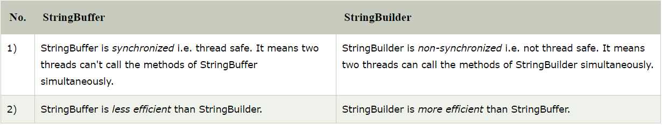
StringBuilder and String Buffer

Slide 19
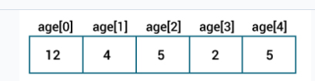
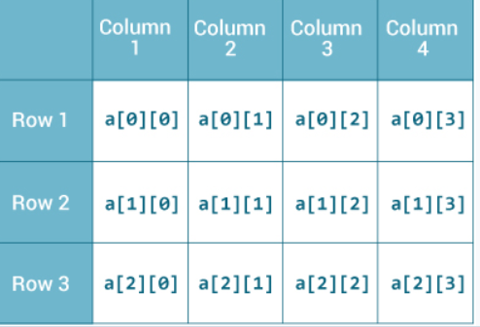
Array
One Dimensional Array
Multidimensional Array
Assignment –
Find the average and sum of salary.
Find top most salary

Slide 20
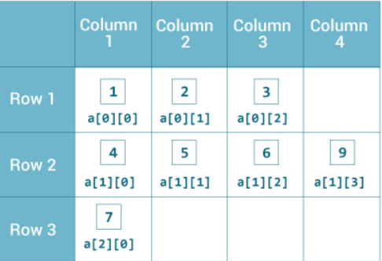
Multidimensional Array
int[][] a = {
{1, 2, 3},
{4, 5, 6, 9},
{7},
};

Slide 21
Array
Advantages
Code Optimization
Random Access
Disadvantages
Size Limit

Slide 22
Class
User Defined Data Type
https://www.iitk.ac.in/esc101/05Aug/tutorial/java/concepts/class.html

Slide 23
Object
An object consists of :
State: It is represented by attributes of an object. It also reflects the properties of an object.
Behavior: It is represented by methods of an object. It also reflects the response of an object with other objects.
Identity: It gives a unique name to an object and enables one object to interact with other objects.
Eg: Employee, Student

Slide 24
Object Instance
An object is an instance of a class, and may be called a class instance or class object; instantiation is then also known as construction.

Slide 25
Object Vs Object Instance
An instance is a specific representation of an object. An object is a generic thing while an instance is a single object that has been created in memory. Usually an instance will have values assigned to it's properties that differentiates it from other instances of the type of object.

Slide 26
5 ways to create Object
New Keyword
Using newInstance() method of Class class
Using newInstance() method of Constructor class
Using clone() method:
Using Deserialization

Slide 27
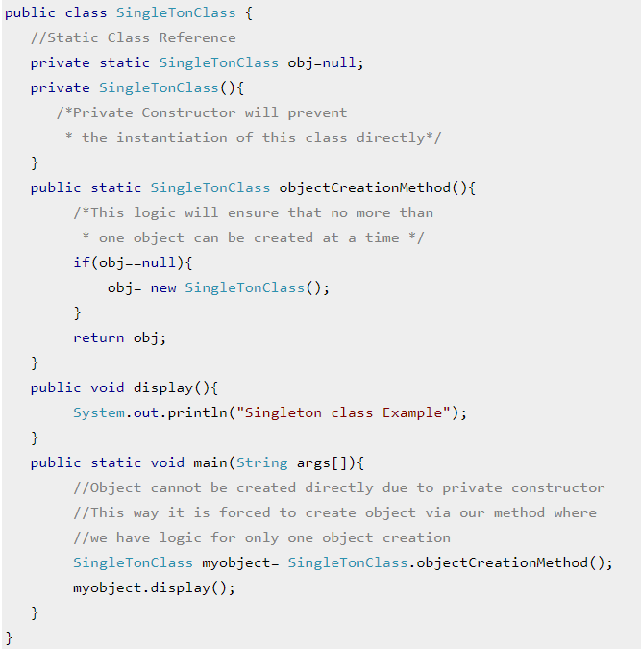
Private Constructor
The use of private constructor is to serve singleton classes. A singleton class is one which limits the number of objects creation to one. Using private constructor we can ensure that no more than one object can be created at a time. By providing a private constructor you prevent class instances from being created in any place other than this very class.

Slide 28
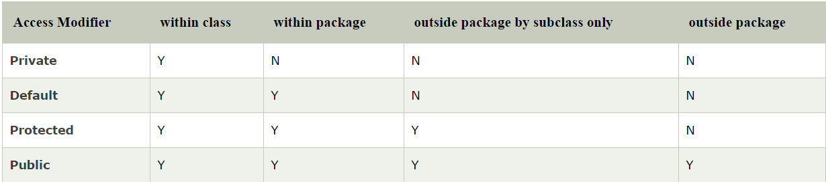
Access Modifiers

Slide 29
Constructor
constructor is a block of codes similar to the method. It is called when an instance of the class is created.
At the time of calling constructor, memory for the object is allocated in the memory.
Every time an object is created using the new() keyword, at least one constructor is called.
It calls a default constructor if there is no constructor available in the class

Slide 30
Rules of Constructor
Constructor name must be the same as its class name
A Constructor must have no explicit return type
A Java constructor cannot be abstract, static, final, and synchronized

Slide 31
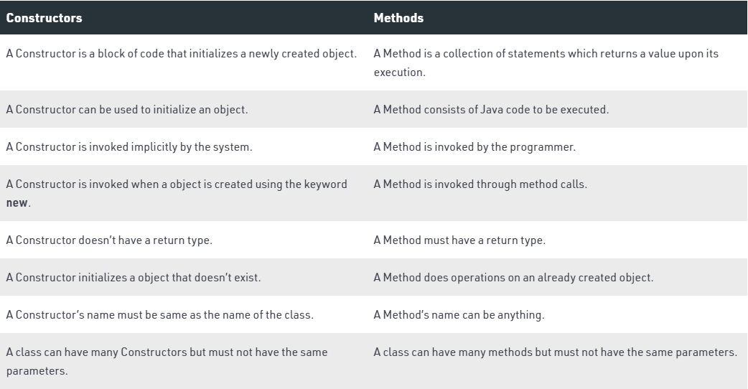
Constructor Vs Method

Slide 32
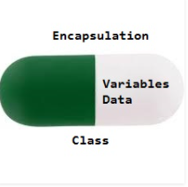
Encapsulation
Advantages
Data Hiding: The user will have no idea about the inner implementation of the class. It will not be visible to the user how the class is storing values in the variables. The user will only know that we are passing the values to a setter method and variables are getting initialized with that value.
Increased Flexibility: We can make the variables of the class as read-only or write-know that only depending on our requirement. If we wish to make the variables read-only then we have to omit the setter methods like setName(), setAge(), etc. from the above program or if we wish to make the variables as write-only then we have to omit the get methods like getName(), getAge(), etc. from the above program
Reusability: Encapsulation also improves the re-usability and easy to change with new requirements.
Testing code is easy: Encapsulated code is easy to test for unit testing.

Slide 33
Printf Format Strings
//printf Format Strings
System.out.printf(" Hello%nAll ");
System.out.printf("'%s' %n", "Java"); //Java
System.out.printf("'%S' %n", "java"); //JAVA
System.out.printf("'%15s' %n", "java"); // java
System.out.printf("'%5.2f'%n", 5.1473);

Slide 34
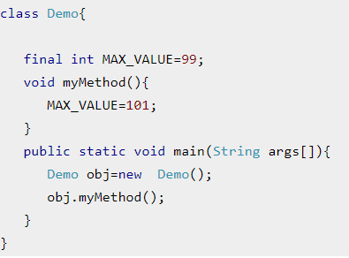
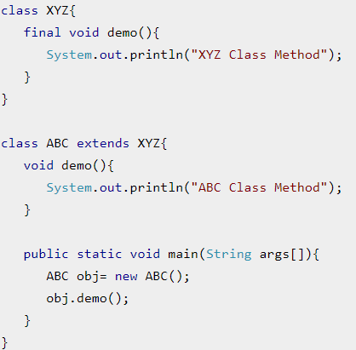
final
1) final variable - constant 2) final method - A final method cannot be overridden. 3) final class - We cannot extend a final class

Slide 35
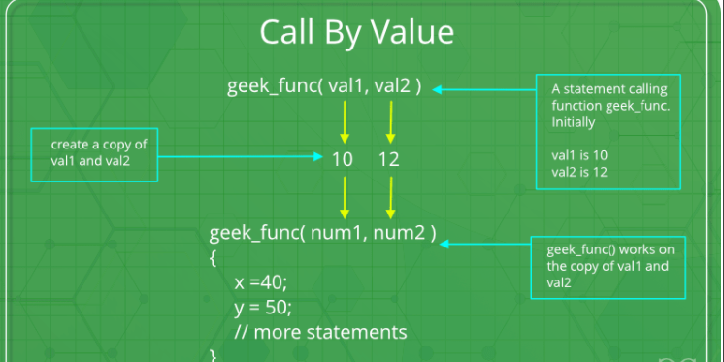
Passing Parameters

Slide 36
Comparing Object
Java provides the two methods of the Object class to compare the objects are as follows:
Java equals() Method
Java hashCode() Method
In Java, the == operator compares that two references are identical or not. Whereas the equals() method compares two objects.
Objects are equal when they have the same state (usually comparing variables). Objects are identical when they share the class identity.

Slide 37
Hashcode()
It is a unique id provided by JVM to Java object. Each Java object is associated with the hash code.
Remember: When we override the equals() method, it is necessary to override the hashCode() method, also.
The general contract for hashCode is:
When it is invoked more than once during the execution of an application, the hashCode() method will consistently return the same hash code (integer value). Note that the object should not be modified.
If the two objects are equal according to the equals() method, then invoking the hashCode() method on these two objects must produce the same integer value.

Slide 38
Garbage Collection
Two ways:
Using System.gc() method
Using Runtime.getRuntime().gc() method
There is no guarantee that any one of above two methods will definitely run Garbage Collector.
The call System.gc() is effectively equivalent to the call : Runtime.getRuntime().gc()

Slide 39
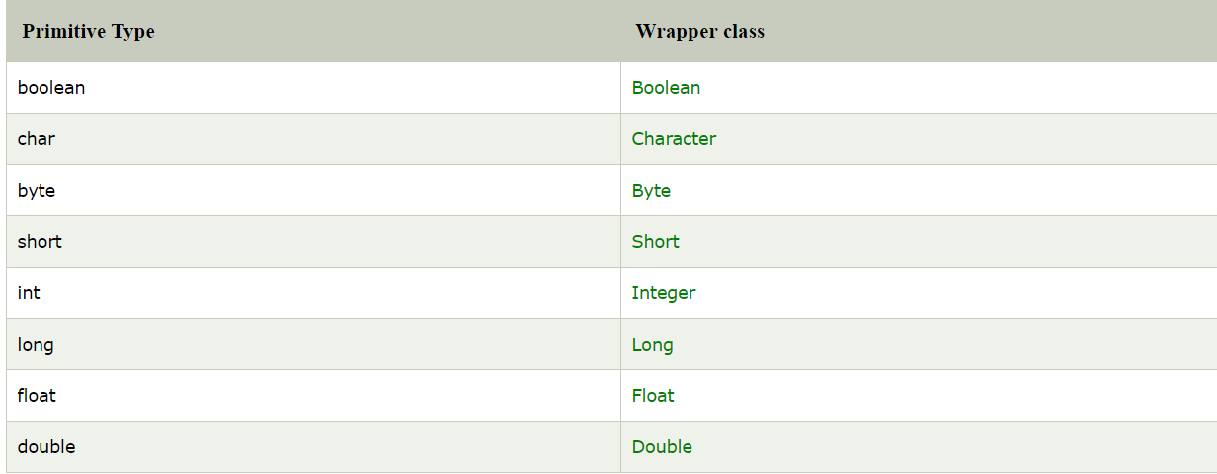
Wrapper Class
The wrapper class in Java provides the mechanism to convert primitive into object and object into primitive.
Autoboxing and Unboxing

Slide 40
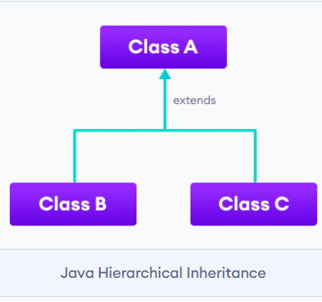
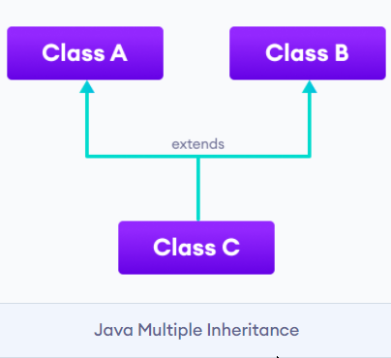
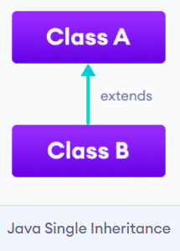
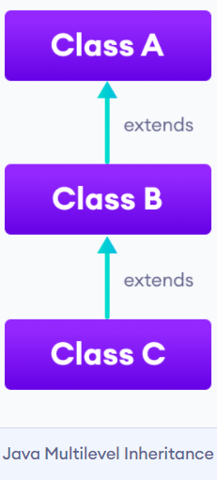
Inheritance

Slide 41
Why Inheritance?
Java is code reusability
runtime polymorphism

Slide 42
Object Class
Object class is the parent class of all the classes in java by default
Object methods

Slide 43
Exception
An exception is an abnormal condition which occurs during run time and disrupts the normal flow of the program.
This exception must be handled to maintain the normal flow of the program. If this exception is not handled properly, the rest of the program will not be executed.
Hence, causing the abrupt termination of the program. Therefore, you must handle the exceptions for the smooth flow of the program. To handle the run time exceptions, one mechanism is provided in java and it is called exception handling.

Slide 44
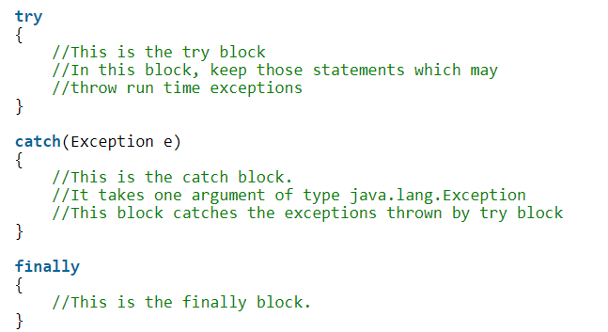
try, catch and finally blocks In Java

Slide 45
Checked Exception Vs Unchecked Exception
Checked:
Checked exceptions are known to compiler i.e they are the exceptions that are checked at compile time. Checked exceptions are also called compile time exceptions, because they can be known during compile time.
Unchecked:
Unchecked exceptions are not known to compiler. They are the exceptions that are not checked at compile time, because they occur only at run time.That’s why these exceptions are also called run time exceptions.

Slide 46
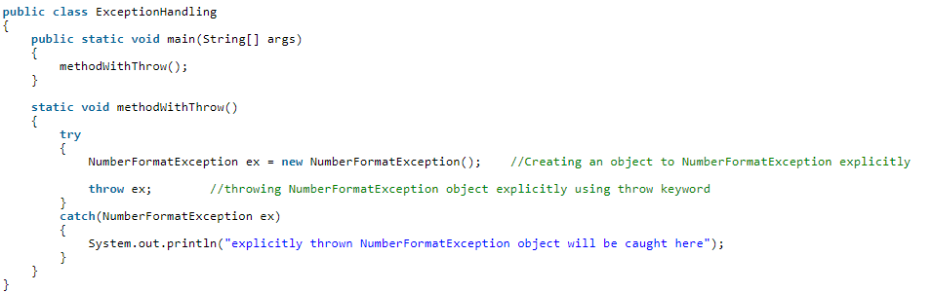
Throw an Exception

Slide 47
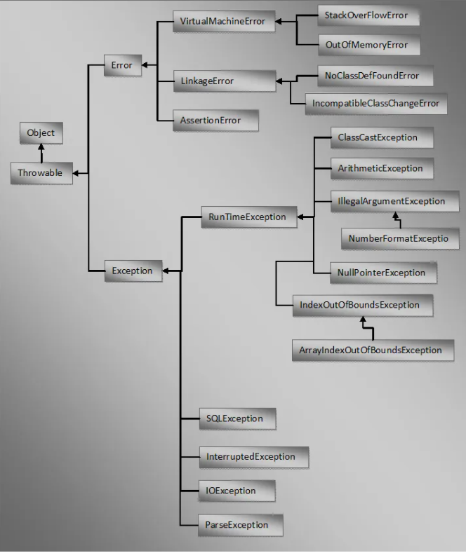

Slide 48
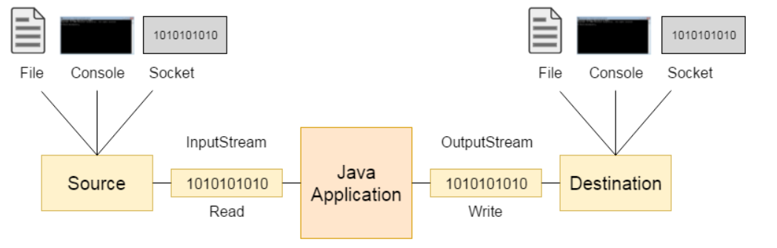
Input/Output Streams
Java I/O (Input and Output) is used to process the input and produce the output.
1) System.out: standard output stream
2) System.in: standard input stream
3) System.err: standard error stream

Slide 49
Scanner
java.util.Scanner in = new java.util.Scanner(System.in);
System.out.print("Enter your name: ");
String name = in.next();
System.out.println("Name is: " + name);
in.close();

Slide 50
Byte Vs Character
Byte oriented reads byte by byte. A byte stream is suitable for processing raw data like binary files. Eg: API – InputStream/OutputStream
In Java, characters are stored using Unicode conventions. Character stream is useful when we want to process text files. These text files can be processed character by character. A character size is typically 16 bits. Eg: API – Reader/Writer

Slide 51
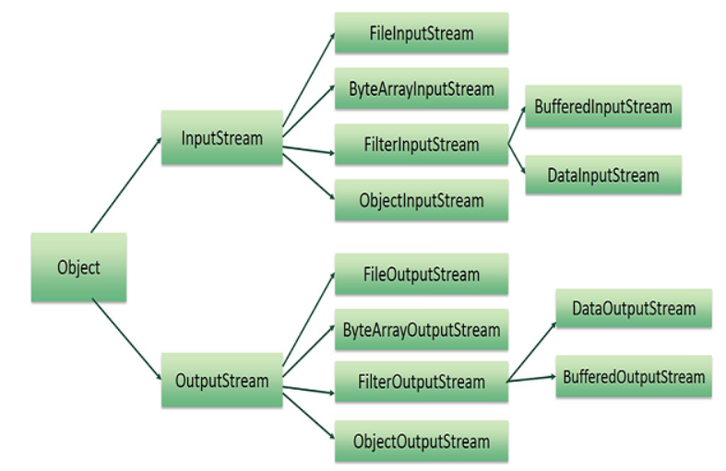
File IO

Slide 52
Abstract Class
1. The abstract class in Java cannot be instantiated (we cannot create objects of abstract classes).
2. If a class have abstract methods, then the class should also be abstract using abstract keyword, else it will not compile.
3. It’s not necessary for an abstract class to have abstract method. We can mark a class as abstract even if it doesn’t declare any abstract methods.
It can have constructors and static methods also.
WHY?
Java Abstract class is used to provide common method implementation to all the subclasses or to provide default implementation.
Assignment: Calculate rate of interest based on two banks where bank would be an abstract class

Slide 53
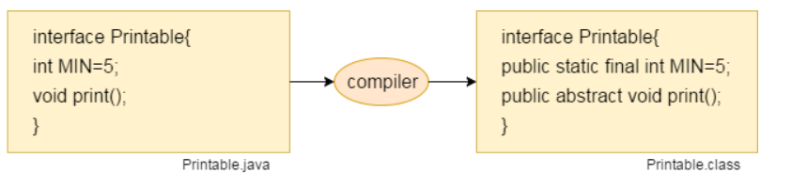
Interface
Java Interface also represents the IS-A relationship.
It cannot be instantiated just like the abstract class.
Why?
It is used to achieve abstraction.
By interface, we can support the functionality of multiple inheritance.
It can be used to achieve loose coupling.

Slide 54
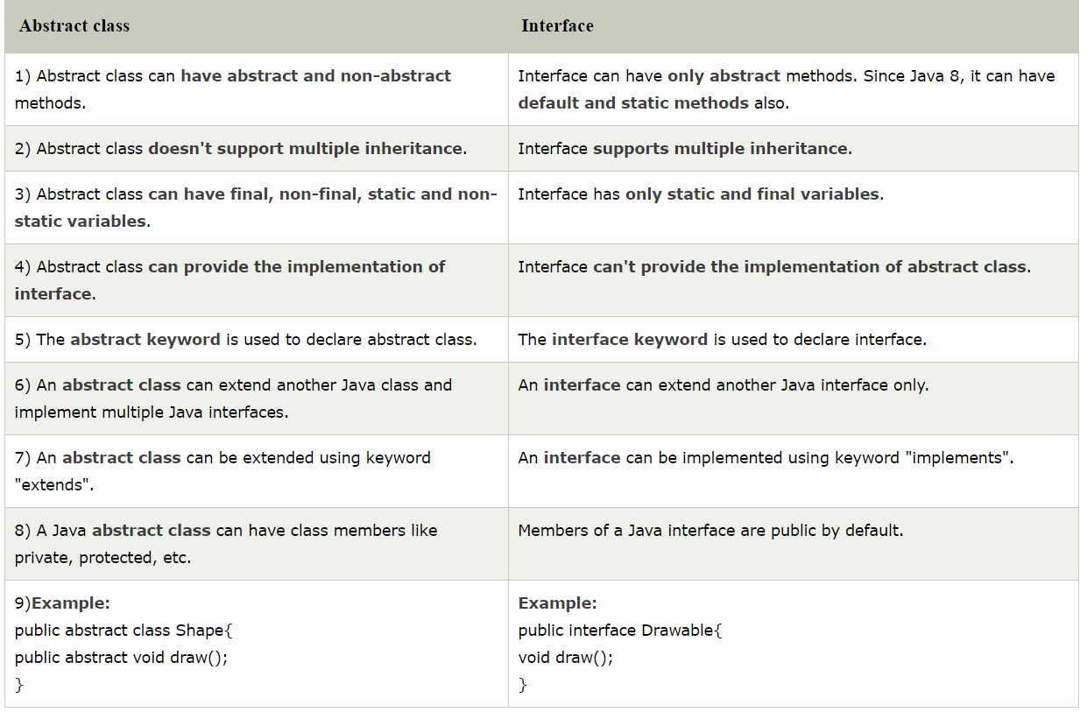
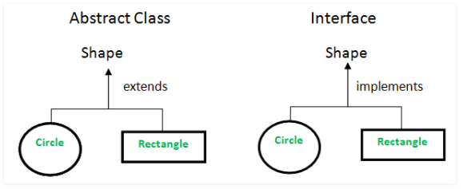
Abstract vs Interface

Slide 55
What is Collection Framework?
Collection Framework in java is a centralized and unified theme to store and manipulate the group of objects.
Java Collection Framework provides some pre-defined classes and interfaces to handle the group of objects.
Using collection framework, you can store the objects as a list or as a set or as a queue or as a map and perform operations like adding an object or removing an object or sorting the objects without much hard work.

Slide 56
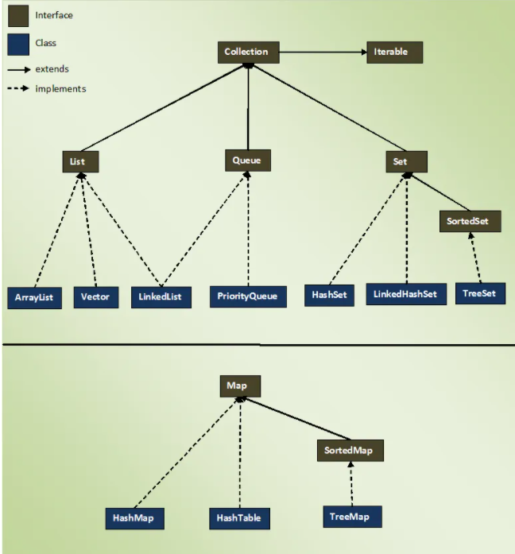
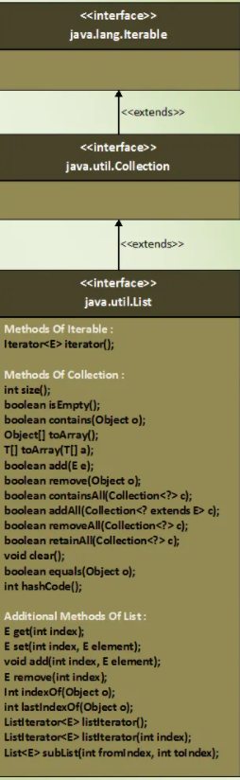
Collection

Slide 57
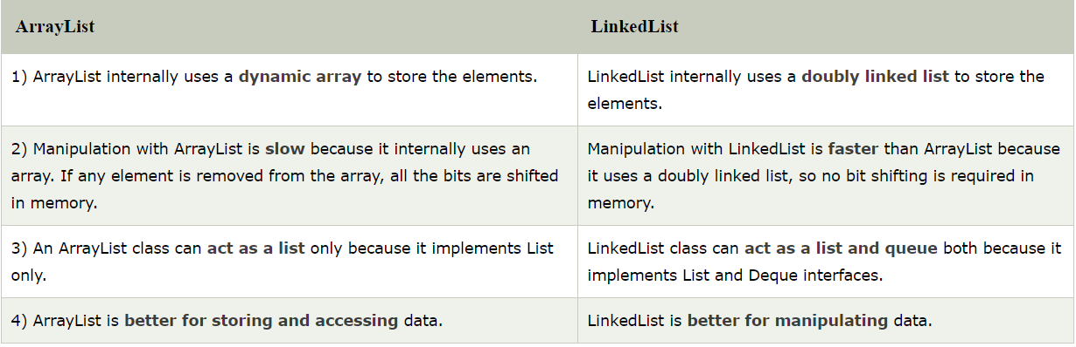

Slide 58
HashSet
HashSet stores the elements by using a mechanism called hashing.
HashSet contains unique elements only.
HashSet allows null value.
HashSet class is non synchronized.
HashSet doesn't maintain the insertion order. Here, elements are inserted on the basis of their hashcode.
HashSet is the best approach for search operations.

Slide 59
LinkedHashSet
Java LinkedHashSet class contains unique elements only like HashSet.
Java LinkedHashSet class provides all optional set operation and permits null elements.
Java LinkedHashSet class is non synchronized.
Java LinkedHashSet class maintains insertion order.

Slide 60
TreeSet
Java TreeSet class contains unique elements only like HashSet.
Java TreeSet class access and retrieval times are quiet fast.
Java TreeSet class doesn't allow null element.
Java TreeSet class is non synchronized.
Java TreeSet class maintains ascending order.

Slide 61
HashMap
Java HashMap contains values based on the key.
Java HashMap contains only unique keys.
Java HashMap may have one null key and multiple null values.
Java HashMap is non synchronized.
Java HashMap maintains no order.

Slide 62
TreeMap
Java TreeMap contains values based on the key. It implements the NavigableMap interface and extends AbstractMap class.
Java TreeMap contains only unique elements.
Java TreeMap cannot have a null key but can have multiple null values.
Java TreeMap is non synchronized.
Java TreeMap maintains ascending order.

Slide 63
Queue
Java Queue interface orders the element in FIFO(First In First Out) manner. In FIFO, first element is removed first and last element is removed at last.

Slide 64
Collections
The Collection in Java is a framework that provides an architecture to store and manipulate the group of objects.
Collections.sort()

